Slide 1
Lintouch Project http://lintouch.org
...the opensource
real-time visual control center...
powered by
Schmitt-Walter Automation GmbH

Slide 2
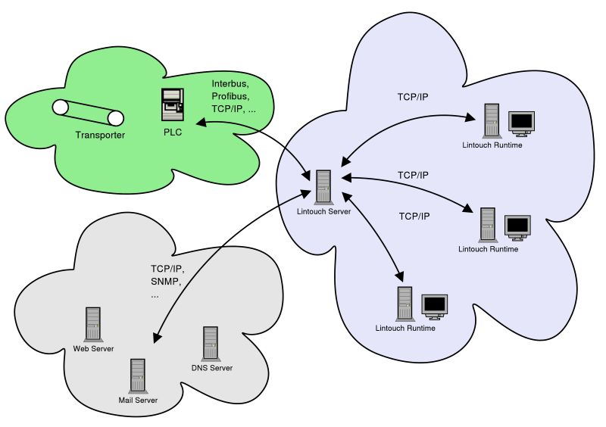
What is Lintouch http://lintouch.org

Slide 3
Lintouch Features http://lintouch.org
Architecture Independent
  PowerPC, ARM, IA32, IA64, ...
Operating System Independent
  Linux, Win32 already supported
Easily extensible on the server side
  write your own plugins
Easily extensible on the client side
  write your own visualization primitives

Slide 4
More Lintouch Features http://lintouch.org
Opensource project
  available under GPL/QPL
Support for standard automation hardware
  Phoenix, Hilscher, SWAC, CC230, TCP/IP
Point and click support for standard automation software
  Robocat, Eplan, Simatic Step 7, ...

Slide 5
Where to get more... http://lintouch.org
Download sources...
Join discussions...
Implement your own features...
Participate in the development...

